Slide 1
Topic models
Source: “Topic models”, David Blei, MLSS ‘09

Slide 2
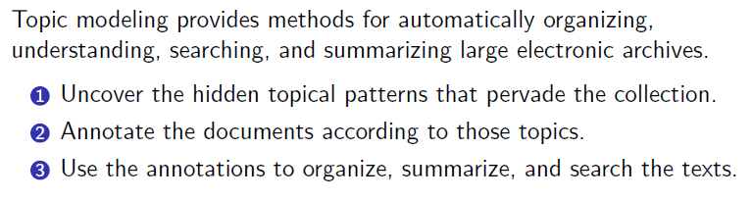
Topic modeling - Motivation
Notes:
Useful lower dimensional representation. (Intepretability is an issue)

Slide 3
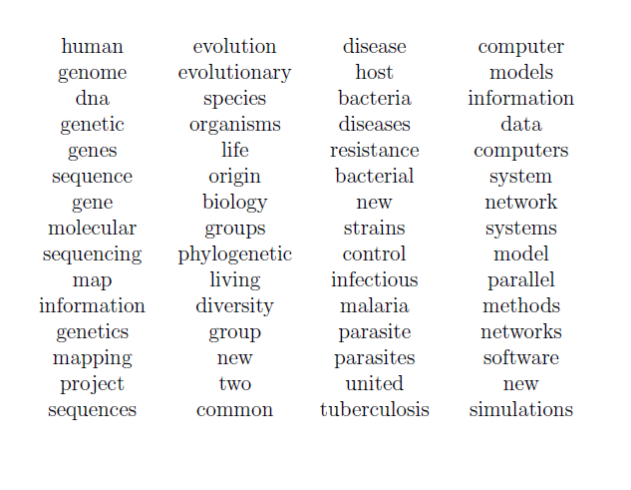
Discover topics from a corpus

Slide 4
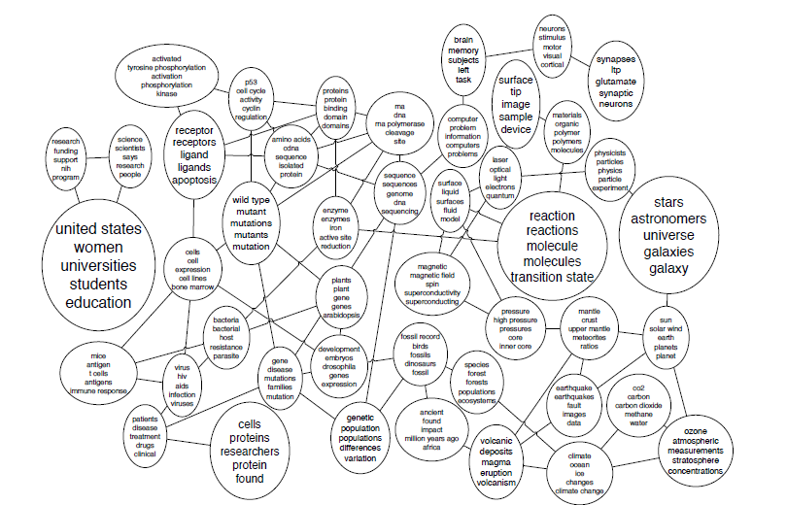
Model connections between topics

Slide 5
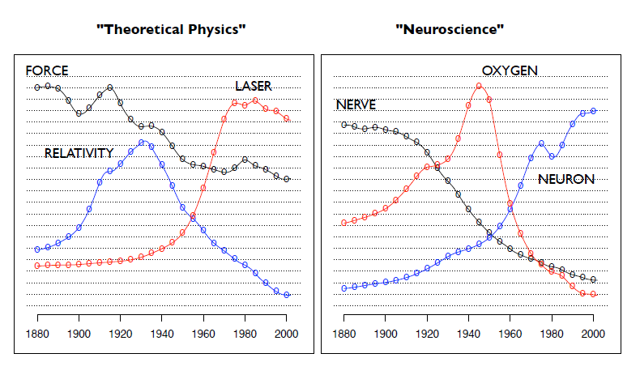
Model the evolution of topics over time

Slide 6
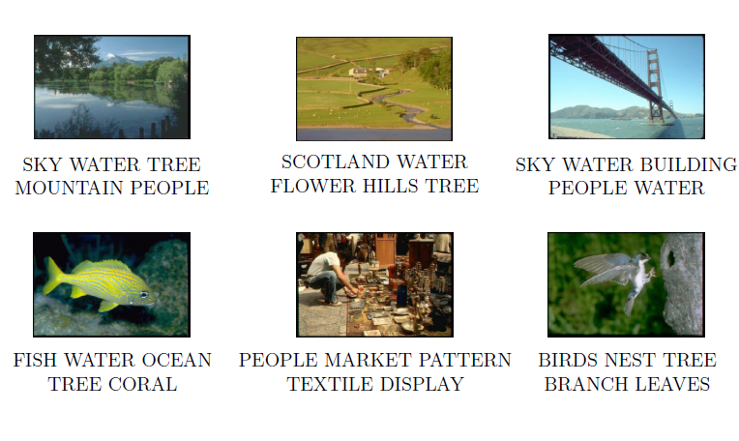
Image annotation

Slide 7
Extensions*
Malleable: Can be quickly extended for data with tags (side information), class label, etc
The (approximate) inference methods can be readily translated in many cases
Most datasets can be converted to ‘bag-of-words’ format using a codebook representation and LDA style models can be readily applied (can work with continuous observations too)
*YMMV

Slide 8
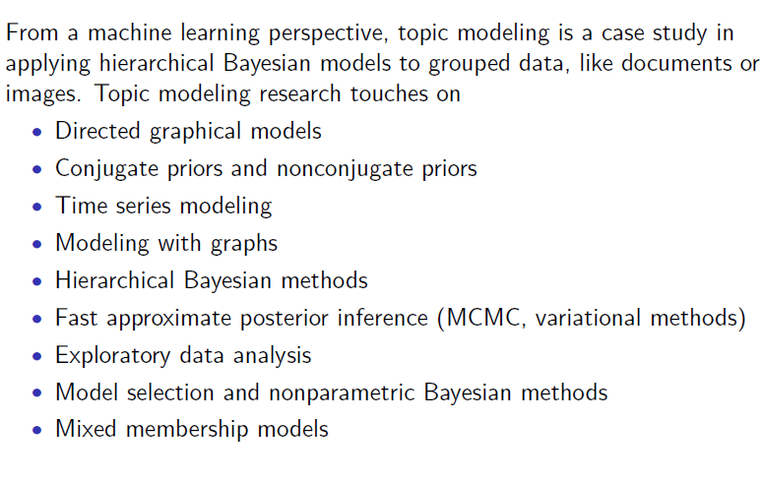
Connection to ML research

Slide 9
Latent Dirichlet Allocation

Slide 10
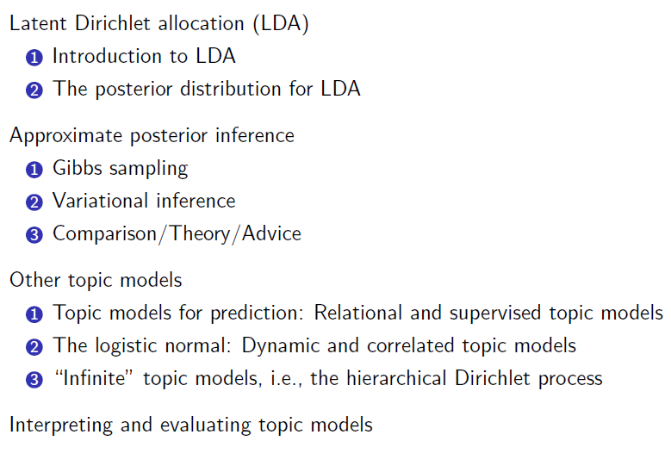
LDA

Slide 11
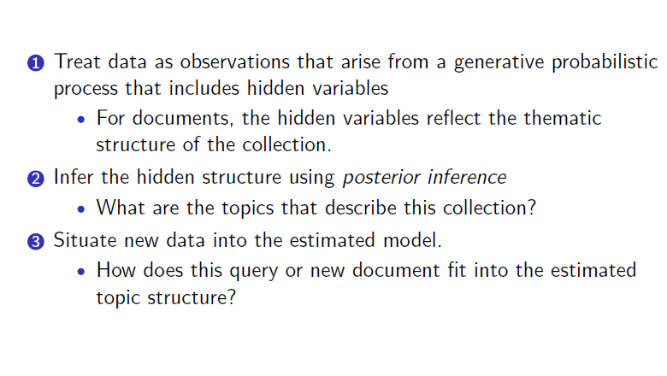
Probabilistic modeling

Slide 12
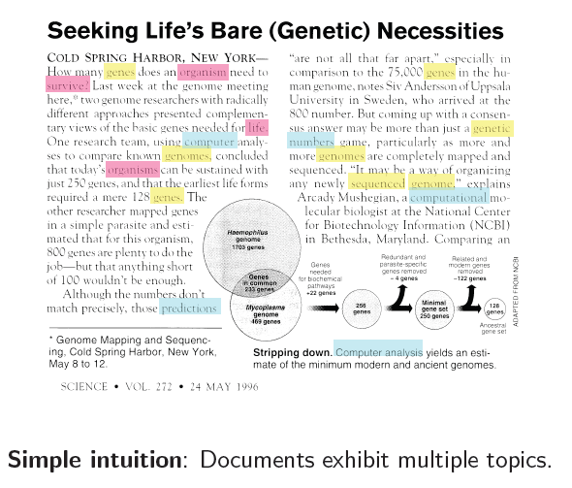
Intuition behind LDA

Slide 13
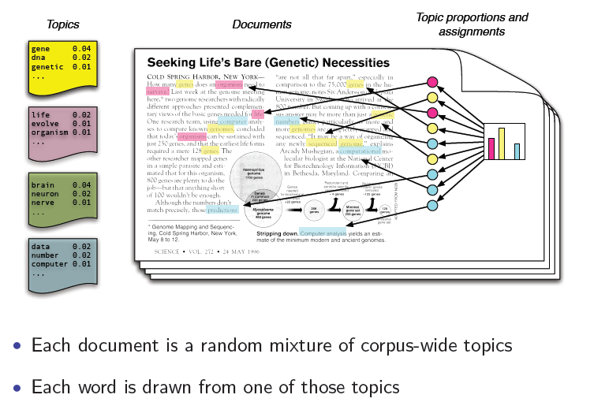
Generative model

Slide 14
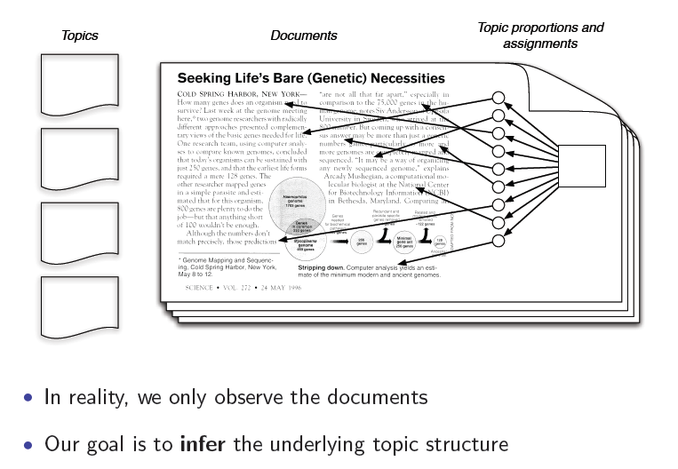
The posterior distribution

Slide 15
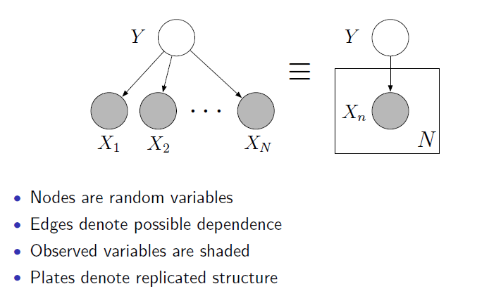
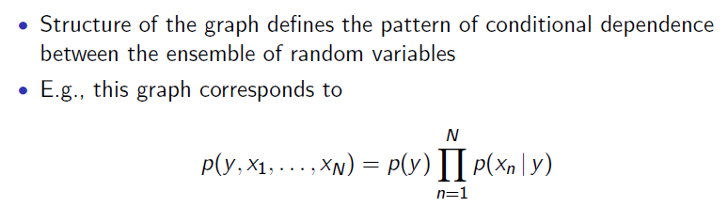
Graphical models (Aside)

Slide 16
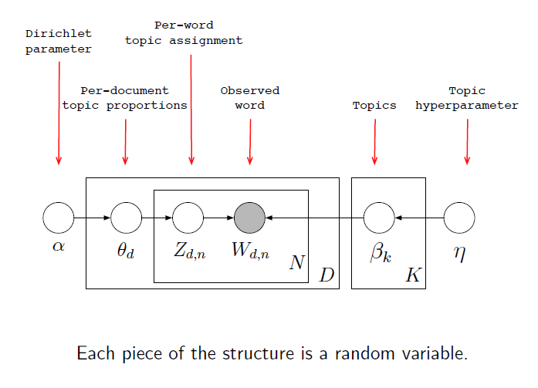
LDA model

Slide 17
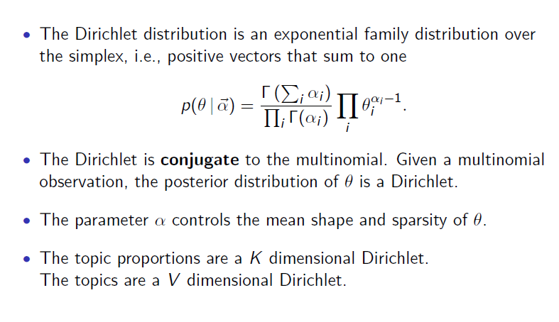
Dirichlet distribution

Slide 18
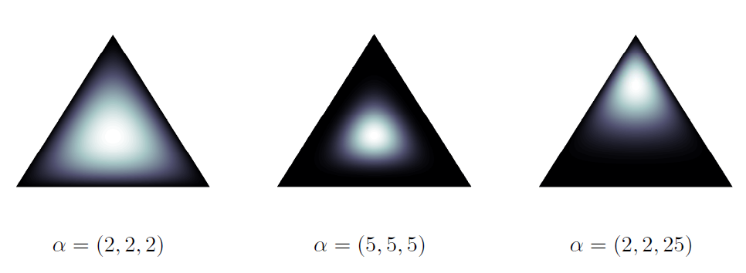
Dirichlet Examples
Darker implies lower magnitude
\alpha < 1 leads to sparser topics

Slide 19
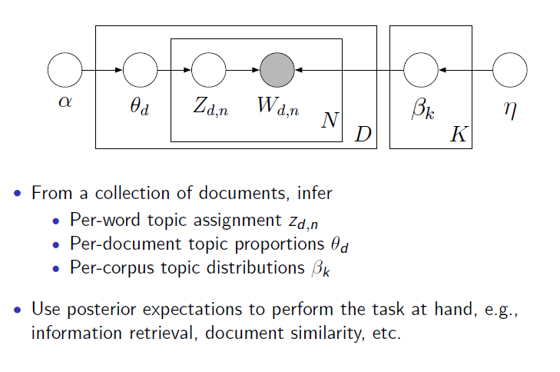
LDA

Slide 20
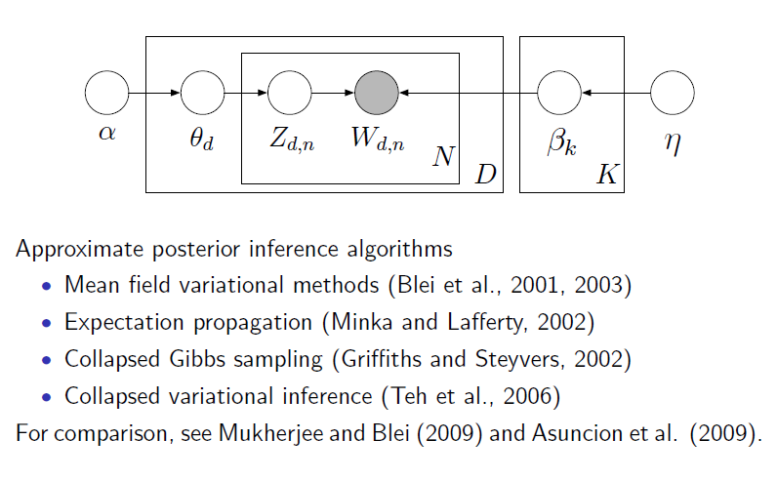
Inference in LDA

Slide 21
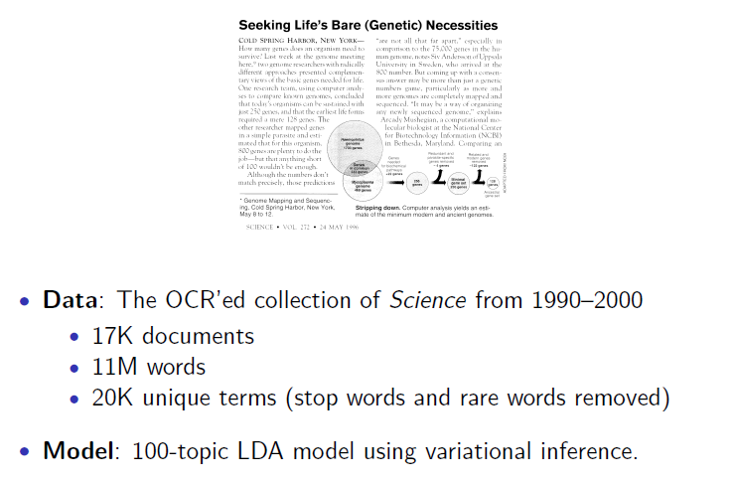
Example inference

Slide 22
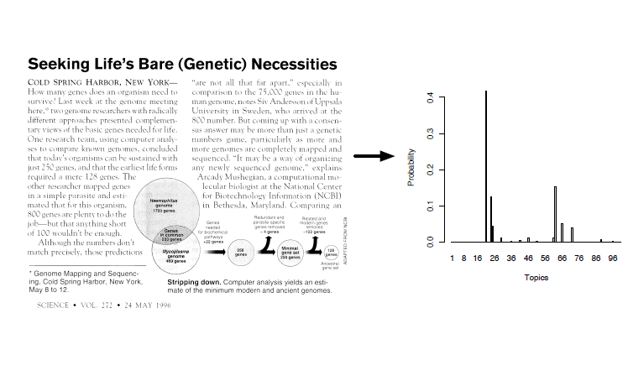
Example inference

Slide 23
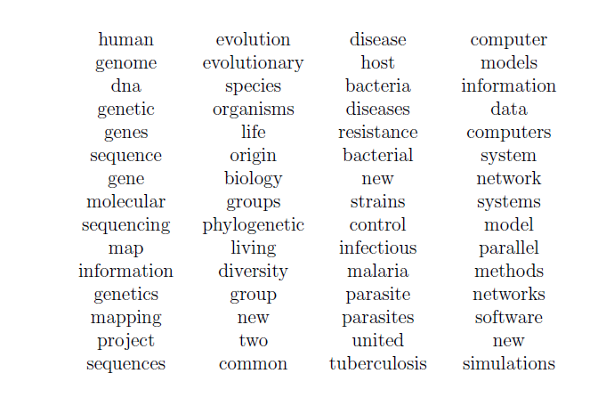
Topics vs words

Slide 24
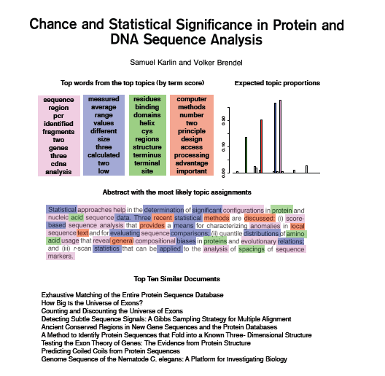
Explore and browse document collections

Slide 25
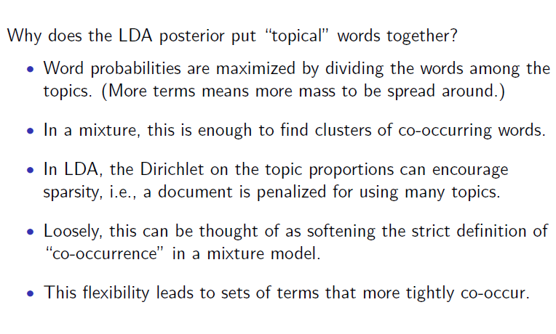
Why does LDA “work” ?

Slide 26
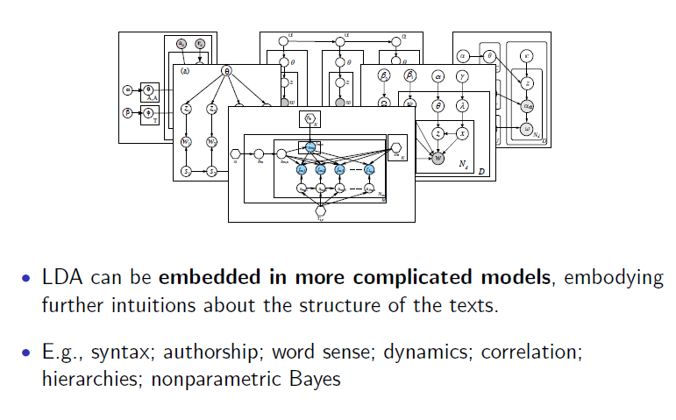
LDA is modular, general, useful

Slide 27
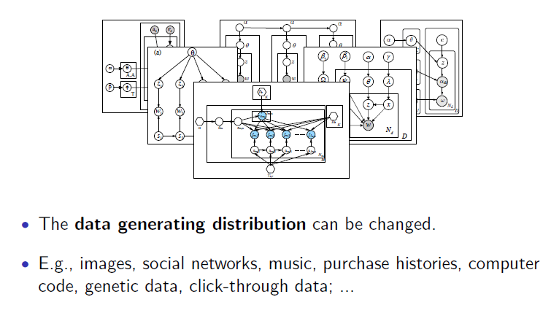
LDA is modular, general, useful

Slide 28
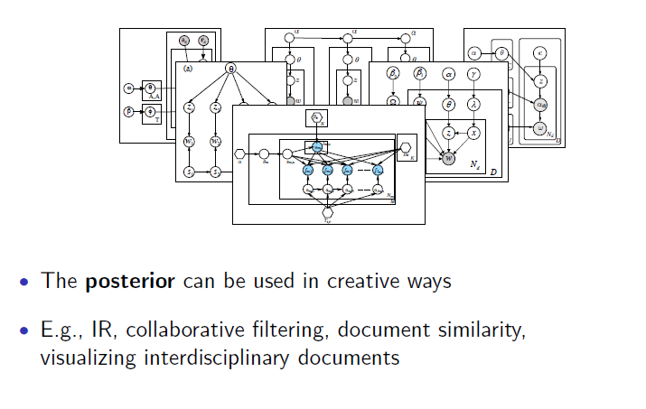
LDA is modular, general, useful

Slide 29
Approximate inference
An excellent reference is “On smoothing and inference for topic models” Asuncion et al. (2009).

Slide 30
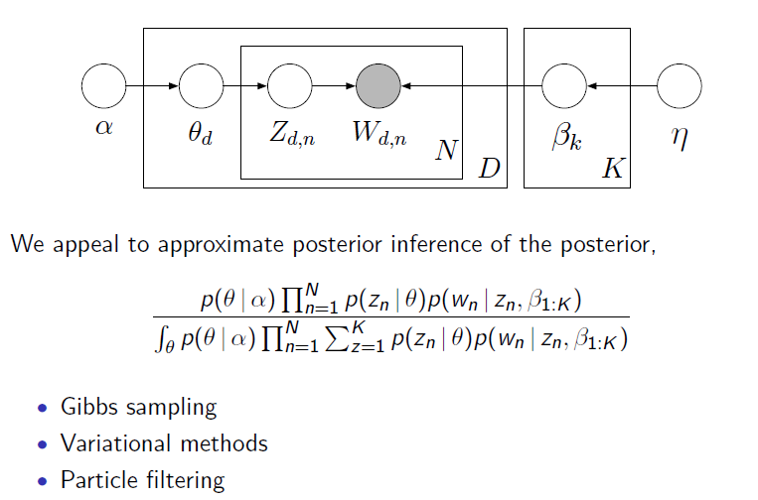
Posterior distribution for LDA
The only parameters we need to estimate are \alpha, \beta

Slide 31
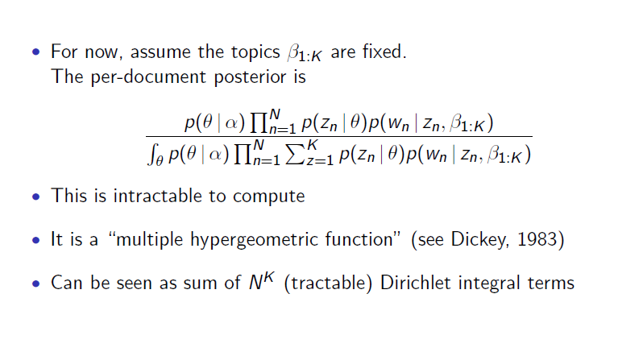
Posterior distribution

Slide 32
Posterior distribution for LDA
Can integrate out either \theta or z, but not both
Marginalize \theta => z ~ Polya (\alpha)
Polya distribution also known as Dirichlet compound multinomial (models “burstiness”)
Most algorithms marginalize out \theta

Slide 33
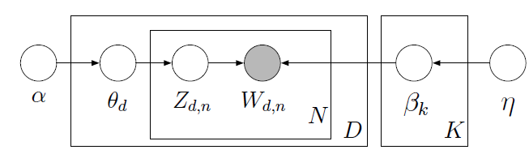
MAP inference
Integrate out z
Treat \theta as random variable
Can use EM algorithm
Updates very similar to that of PLSA (except for additional regularization terms)

Slide 34
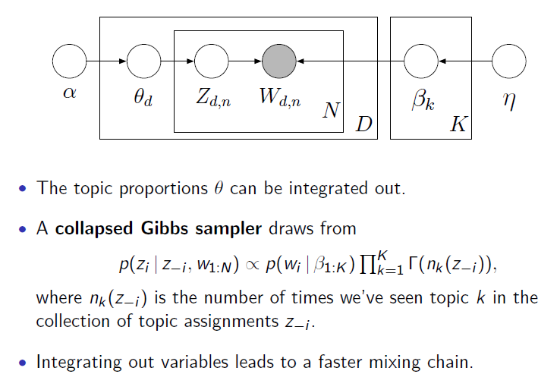
Collapsed Gibbs sampling

Slide 35
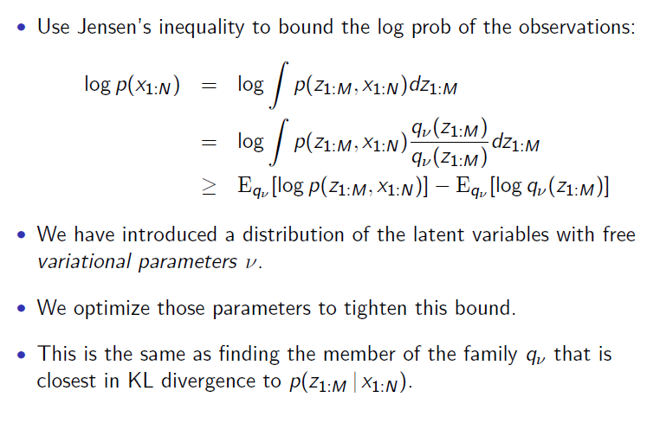
Variational inference
Can think of this as extension of EM where we compute expectations w.r.t
“variational distribution” instead of true posterior

Slide 36
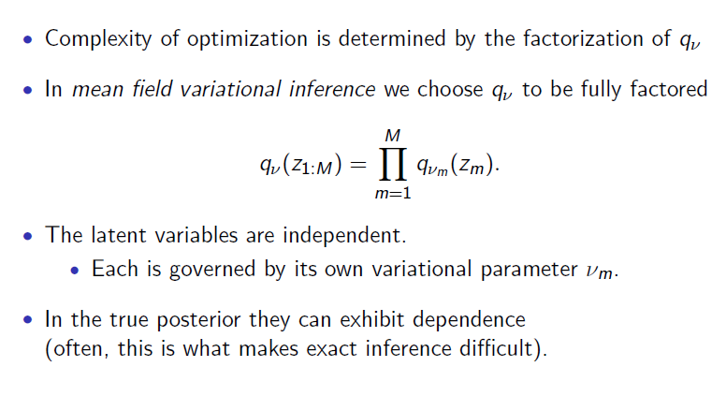
Mean field variational inference

Slide 37
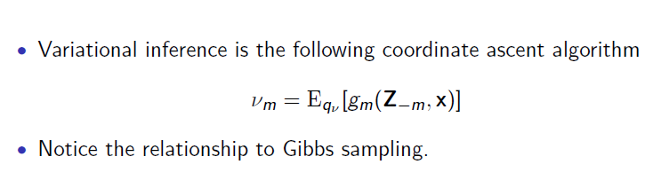
MFVI and conditional exponential families

Slide 38
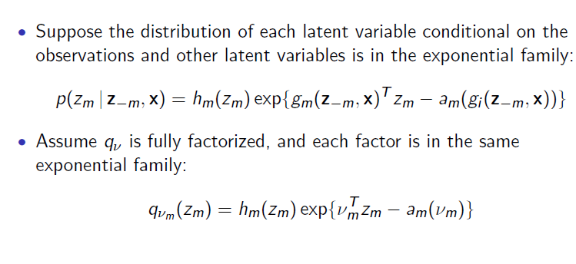
MFVI and conditional exponential families

Slide 39
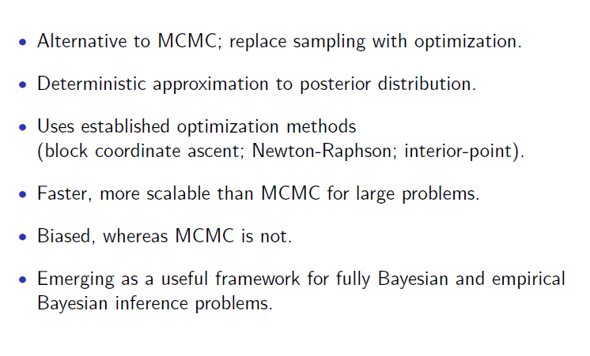
Variational inference

Slide 40
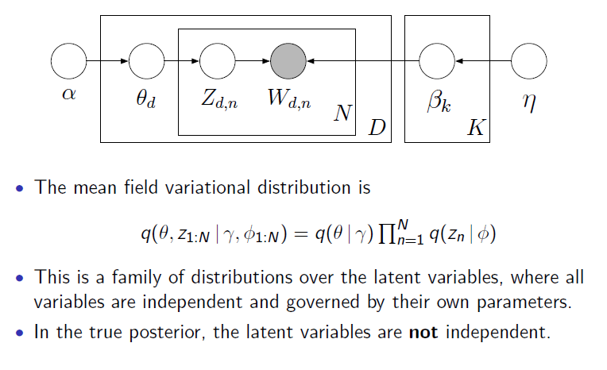
Variational inference for LDA

Slide 41
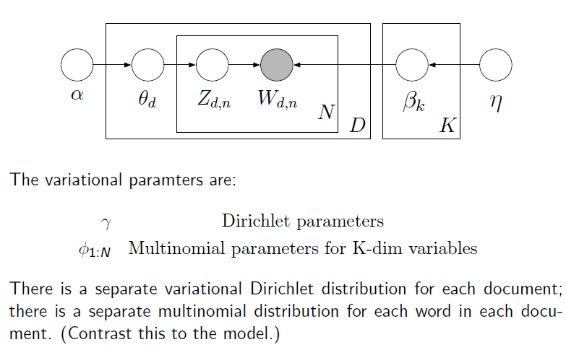
Variational inference for LDA

Slide 42
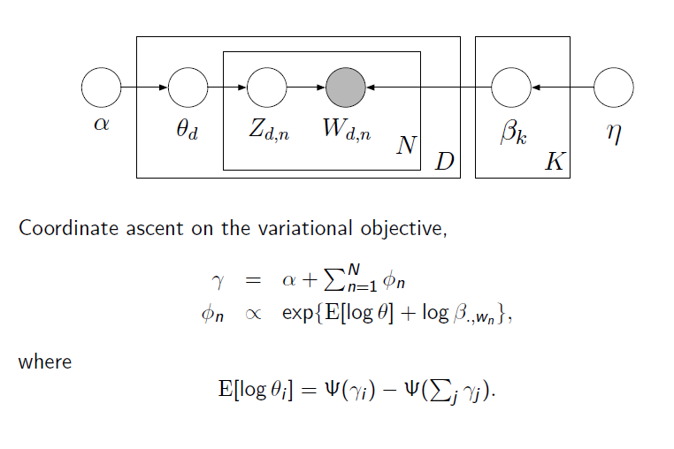
Variational inference for LDA

Slide 43
Collapsed variational inference
MFVI: \theta, z assumed to be independent
\theta can be marginalized out exactly
Variational inference algorithm operating on the “collapsed space” as CGS
Strictly better lower bound than VB
Can think of “soft” CGS where we propagate uncertainty by using probabilities than samples

Slide 44
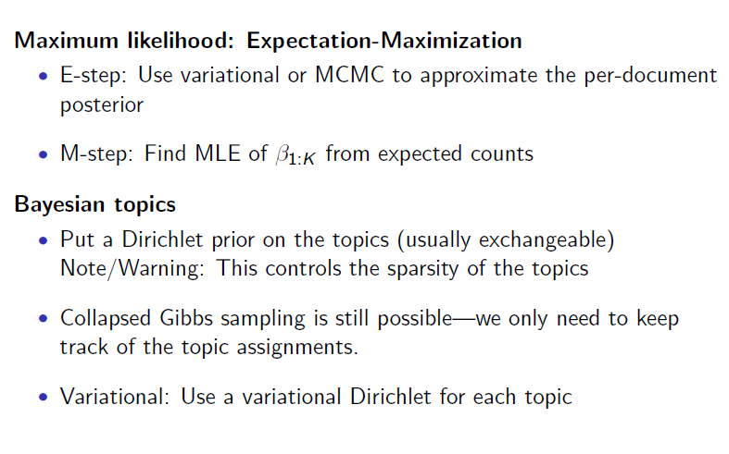
Estimating the topics

Slide 45
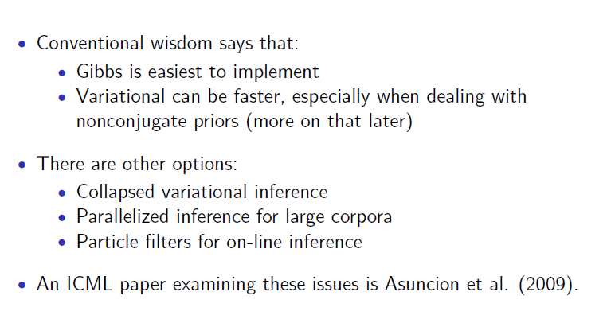
Inference comparison

Slide 46
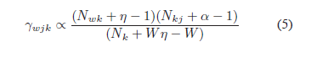
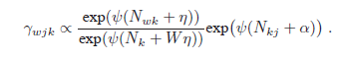
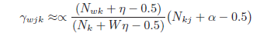
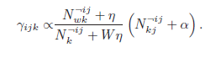
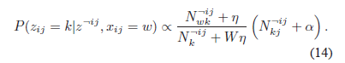
Comparison of updates
MAP
VB
CVB0
CGS
“On smoothing and inference for topic models” Asuncion et al. (2009).

Slide 47
Choice of inference algorithm
Depends on vocabulary size (V) , number of words per document (say N_i)
Collapsed algorithms – Not parallelizable
CGS - need to draw multiple samples of topic assignments for multiple occurrences of same word (slow when N_i >> V)
MAP – Fast, but performs poor when N_i << V
CVB0 - Good tradeoff between computational complexity and perplexity

Slide 48
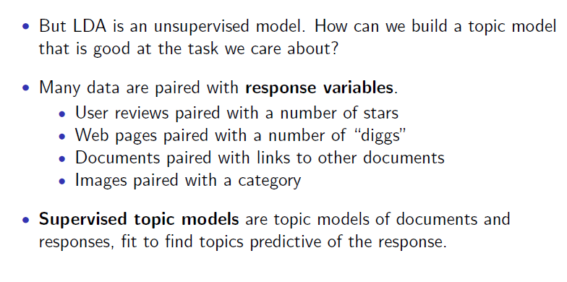
Supervised and relational topic models

Slide 49
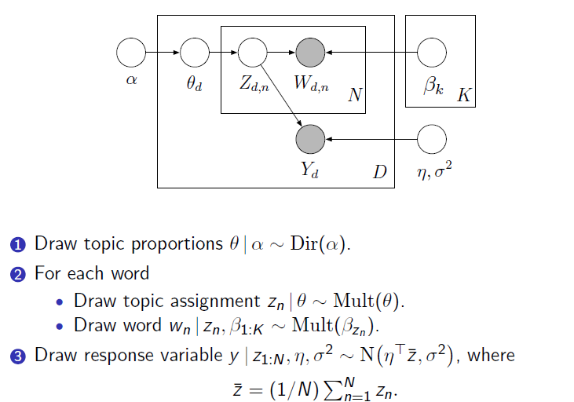
Supervised LDA

Slide 50
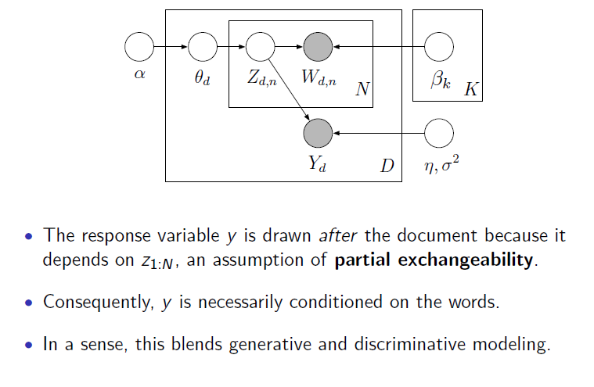
Supervised LDA

Slide 51
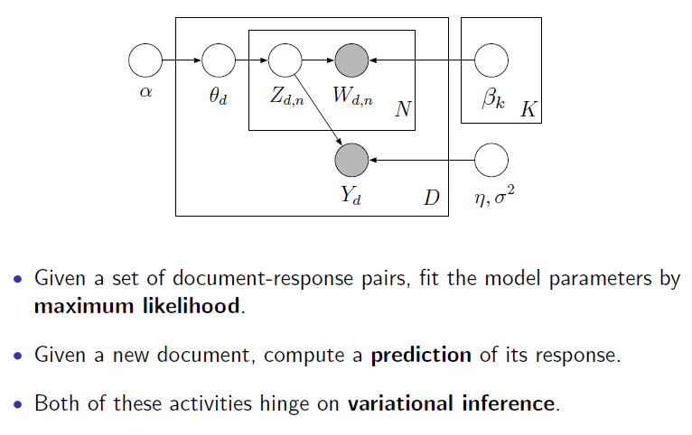
Supervised LDA

Slide 52
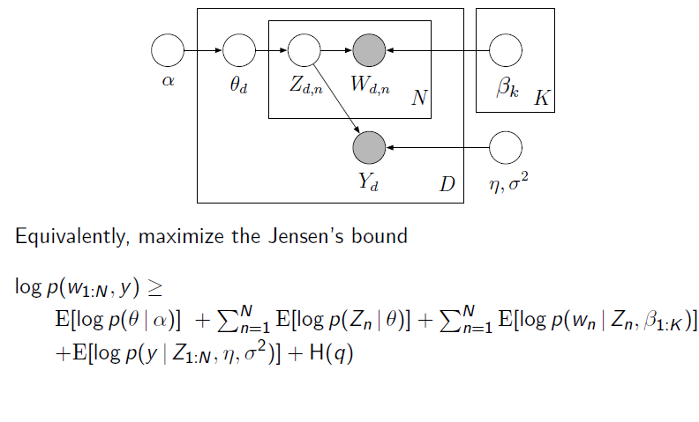
Supervised LDA

Slide 53

Variational inference in sLDA

Slide 54

ML estimation

Slide 55

Prediction

Slide 56

Example: Movie reviews

Slide 57

Diverse response types with GLMs

Slide 58

Example: Multi class classification

Slide 59

Supervised topic models

Slide 60


Upstream vs downstream models
Upstream: Conditional models
Downstream: The predictor variable is generated based on
actually observed z than \theta which is E(z’s)

Slide 61

Relational topic models

Slide 62

Relational topic models

Slide 63

Relational topic models

Slide 64

Predictive performance of one type given the other

Slide 65

Predicting links from documents

Slide 66

Predicting links from documents

Slide 67
Things we didn’t address
Model selection: Non parametric Bayesian approaches
Hyperparameter tuning
Evaluation can be a bit tricky (comparing approximate bounds) for LDA, but can use traditional metrics in supervised versions

Slide 68
Thank you!

